Slide 1

B.Tech Computer Science & Business Systems
CB23721 – Project Evaluation I
Review 2 – 01/09/2026

Slide 2
VeritasRAG: A Hallucination-Flagging Layer for RAG
Team Members :
Architha M - 231401013
Dhanvin Kadiir – 231401022
Guide :
Mrs. Poornimathi K
Assistant Professor(SG)
B.Tech Computer Science and Business Systems

Slide 3
INTRODUCTION
Background
LLMs can generate fluent but incorrect or unsupported information.
RAG improves factuality by retrieving relevant external documents.
However, RAG does not completely eliminate hallucinations.
VeritasRAG provides real-time verification of generated responses.
Problem
Existing RAG systems do not clearly identify grounded, inferred, and hallucinated content.
Users cannot easily see which claims are supported by retrieved evidence.

Slide 4
Objectives
Develop a non-invasive, model-agnostic middleware for real-time verification of RAG outputs.
Implement an ensemble engine utilizing Embedding Similarity, NLI, and Atomic Fact Entailment.
Provide sentence-level and claim-level grounding scores with linked evidence overlays.
Achieve a P95 latency of under 2 seconds through parallel execution and Redis caching.
Evaluate system performance on RAGTruth and HaluEval benchmarks targeting ≥82% accuracy.
Scope Of Work
To develop a real-time, model-agnostic middleware that verifies RAG-generated content at sentence/claim level and provides evidence-linked grounding scores with low latency.

Slide 5
Literature Review
No. | Author(s) & Year | Title of Paper | Methodology / Approach | Key Findings | Limitations / Research Gap | Relevance to Current Project
1. | Lewis et al., 2020 | Retrieval-Augmented Generation for Knowledge-Intensive NLP Tasks | DPR + BART with retrieved passages | RAG improves knowledge-intensive tasks | No output verification | Base RAG architecture
2. | Min et al., 2023 | FActScore: Fine-grained Atomic Evaluation of Factual Precision in Long Form Text Generation | Atomic facts + NLI | Enables fine-grained factual evaluation | Offline; costly | Atomic verification
3. | Niu et al., 2024 | RAGTruth: A Hallucination Corpus for Developing Trustworthy RAG Language Models | Hallucination annotations | Identifies hallucinations in RAG | No real-time system | Main benchmark
4. | Asai et al., 2024 | Self-RAG: Learning to Retrieve, Generate, and Critique through Self-Reflection | Retrieval + self-critique | Improves factuality | Requires fine-tuning | Model-agnostic comparison

Slide 6
No. | Author(s) & Year | Title of Paper | Methodology / Approach | Key Findings | Limitations / Research Gap | Relevance to Current Project
5. | Es et al., 2024 | RAGAs: Automated Evaluation of Retrieval Augmented Generation | LLM-based evaluation | Measures faithfulness/relevance | Expensive; offline | Real-time gap
6. | Manakul et al., 2023 | SelfCheckGPT: Zero-Resource Black-Box Hallucination Detection | Multiple responses + NLI | Detects inconsistent hallucinations | High inference cost | Efficient verification
7. | Gao et al., 2024 | Retrieval-Augmented Generation for Large Language Models: A Survey | RAG architecture survey | Identifies RAG challenges | No runtime solution | Modular verification
8. | Wei et al., 2024 | SAFE: Search-Augmented Factuality Evaluator | Atomic facts + search | Improves factuality checking | High latency | Evidence verification

Slide 7
No. | Author(s) & Year | Title of Paper | Methodology / Approach | Key Findings | Limitations / Research Gap | Relevance to Current Project
9. | Huang et al., 2023 | A Survey on Hallucination in Large Language Models | Hallucination survey | Identifies causes of hallucination | No implementation | Theoretical basis
10. | He et al., 2021 | DeBERTa: Decoding-enhanced BERT with Disentangled Attention | DeBERTa + NLI | Strong NLI performance | Cross-encoder latency | Approach B
11. | Yan et al., 2024 | Corrective Retrieval Augmented Generation | Retrieval evaluation + correction | Improves retrieval quality | Pre-generation only | Complementary approach
12. | Barnett et al., 2024 | Seven Failure Points When Engineering a Retrieval Augmented Generation System | RAG failure analysis | Identifies practical failures | No runtime detection | Failure identification

Slide 8
No. | Author(s) & Year | Title of Paper | Methodology / Approach | Key Findings | Limitations / Research Gap | Relevance to Current Project
13. | Li et al., 2023 | HaluEval: A Large-Scale Hallucination Evaluation Benchmark for Large Language Models | Hallucination benchmark | Evaluates hallucination detection | Not RAG-specific | Secondary benchmark
14. | Laban et al., 2024 | FaithBench: A Diverse Hallucination Benchmark for Summarization by Modern LLMs | Faithfulness benchmark | Tests subtle hallucinations | Single methods may fail | Ensemble approach
15. | Reimers & Gurevych, 2019 | Sentence-BERT: Sentence Embeddings using Siamese BERT-Networks | Sentence embeddings | Efficient semantic similarity | Similarity ≠ entailment | Approach A

Slide 9
Comparative Analysis
Existing Work | Key Limitation | VeritasRAG Advantage
RAG – Lewis et al. | No hallucination verification | Adds post-generation verification
FActScore – Min et al. | Offline evaluation | Real-time claim verification
RAGTruth – Niu et al. | Benchmark, not a system | Used for evaluation
Self-RAG – Asai et al. | Requires model fine-tuning | Model-agnostic
RAGAs – Es et al. | High cost; offline | Low-latency verification
SelfCheckGPT – Manakul et al. | Multiple LLM calls | Evidence-based verification
SAFE – Wei et al. | High latency | Uses retrieved RAG evidence

Slide 10
Existing Work | Key Limitation | VeritasRAG Advantage
Sentence-BERT – Reimers & Gurevych | Similarity ≠ factuality | Combined with NLI + fact checking
VeritasRAG | - | Real-time, evidence-linked, model-agnostic

Slide 11
Research Gap Identification
Key Gaps Found in Literature
Lack of real-time hallucination verification in RAG pipelines.
Limited sentence-level and claim-level grounding detection.
Existing approaches may have high latency.
Some methods require LLM fine-tuning or modification.
Lack of evidence-linked and user-friendly grounding output.
Individual verification methods have limitations when used alone.
Justification for Selecting the Project
These gaps indicate the need for a non-invasive, model-agnostic verification layer.
VeritasRAG combines Embedding Similarity, NLI Cross-Encoder, and Atomic Fact Entailment.
It provides grounding scores, cited evidence, and visual output.
The system targets real-time verification with P95 latency below 2 seconds.

Slide 12
Proposed System
VeritasRAG
A pluggable, non-invasive middleware layer for RAG pipelines.
Verifies generated responses at sentence and claim level.
Uses three verification approaches:
  Embedding Similarity
  NLI Cross-Encoder
  Atomic Fact Entailment
Generates grounding scores and evidence-linked output.
Classifies content as:
  Grounded - Green
  Inferred - Yellow
  Hallucinated - Red
Uses Redis caching and parallel execution to achieve low-latency verification.

Slide 13
Work Completed Till Now
Problem Statement finalized
Literature Review of 15 papers completed
Comparative Analysis completed
Research Gaps identified
Objectives and Scope finalized
Proposed System designed
Verification Approaches identified
Technology Stack selected
Project Timeline prepared
SDG Alignment completed

Slide 14
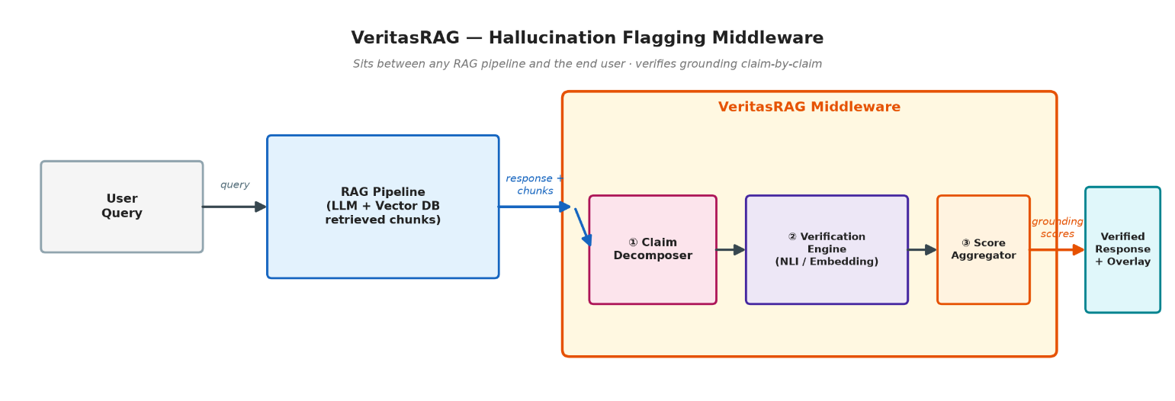
Next Steps
Planned Work for Next Review
Set up repository and CI/CD
Implement sentence splitter
Integrate embedding model
Implement Approach A – Embedding Similarity

Slide 15
Existing Tools — What They Do, and Where They Fall Short
Tool | What It Does | Key Limitation
Vectara HHEM | Single faithfulness score per document | Document-level only — no sentence granularity
RAGAs | Multi-metric offline evaluation via LLM-as-judge | 10–30s latency — cannot run in real time
TruLens | Developer-facing pipeline monitoring dashboard | No user-facing output overlay
Guardrails AI | Binary pass/fail blocking of unsafe outputs | No graded confidence; blocks, doesn't explain
SelfCheckGPT | Samples multiple responses, checks consistency | 3–5× LLM inference cost — impractical for production
Self-RAG | Fine-tunes an LLM to self-generate reflection tokens | Requires fine-tuning — incompatible with GPT-4/Claude API
FActScore | Atomic-fact offline precision evaluation | Offline only (5–15s); Wikipedia-based, not RAG-chunk-based
SAFE | Web-search augmented factuality evaluator | Requires live internet; 30–60s per response

Slide 16
Consolidated Research Gap
No Existing System Provides All of the Following Simultaneously
Real-time verification — under 2 seconds
Sentence-level granularity
Source chunk citations per sentence
Color-coded visual overlay for users
Pipeline-agnostic — no model fine-tuning required
Partial grounding detection within a single sentence
Why This Gap Matters
67% of enterprises cite hallucination as their #1 LLM adoption blocker (Gartner, 2024)
The EU AI Act (2024) mandates transparency for high-risk AI systems — grounding verification is a direct compliance tool
Real incident: a lawyer was sanctioned for submitting 6 AI-fabricated case citations to a federal court (Mata v. Avianca Airlines, 2023)

Slide 17
Proposed Work - How VeritasRAG Works
A pluggable, post-generation middleware that intercepts any RAG pipeline's output and annotates every sentence with a grounding score, inference type, and cited source evidence — in under 2 seconds.
Step-by-Step Workflow
RAG pipeline generates a response using retrieved chunks
VeritasRAG intercepts {response + chunks}
Response is split into individual sentences
Each sentence is verified against retrieved chunks via Embedding Similarity (A), NLI Cross-Encoder (B), and Atomic t Entailment (C)
Scores are aggregated via a weighted ensemble
Output is an annotated JSON + color-coded HTML overlay
Integration — 3 Lines of Code
from veritasrag import VeritasMiddleware
overlay = VeritasMiddleware().verify(response=answer, chunks=chunks)
return {"answer": answer, "grounding": overlay}

Slide 18
Three Verification Approaches
Approach | Method | Model | Latency | Accuracy
A — Embedding | Cosine similarity, sentence vs. chunk | all-MiniLM-L6-v2 | ~200–400ms | ★★☆
B — NLI | Entailment / Neutral / Contradiction | DeBERTa-v3-large-MNLI | ~500–800ms | ★★★
C — Atomic | LLM extracts atomic facts, each verified via NLI | Llama 3.1 8B + NLI | ~1000–2000ms | ★★★★
Ensemble Formula
Final Score = 0.20 × Score A + 0.50 × Score B + 0.30 × Score C
Score Range | Label | Color
≥ 0.85 | Grounded | Green
0.60 – 0.85 | Inferred | Yellow
< 0.60 | Hallucinated | Red

Slide 19
Proof of Concept - Approach A Working Demo
What Was Built
Working Python implementation of Approach A (Embedding Similarity)
Sentence splitting from a RAG response, embedding via all-MiniLM-L6-v2
Cosine similarity scoring against retrieved chunks with threshold classification
Structured JSON overlay output
PoC Demo Output
Query: "What is the capital of France and its population?"
Sentence 1: "Paris is the capital of France."
Score 0.94 → GROUNDED (chunk_001, similarity 0.94)
Sentence 2: "...population of approximately 2.1 million."
Score 0.87 → GROUNDED (chunk_001, similarity 0.87)
Sentence 3: "The city was founded by the Romans in 3rd century BC."
Score 0.21 → HALLUCINATED (no supporting evidence found)
Overall Grounding Score: 0.67 | Processing Time: 387ms

Slide 20
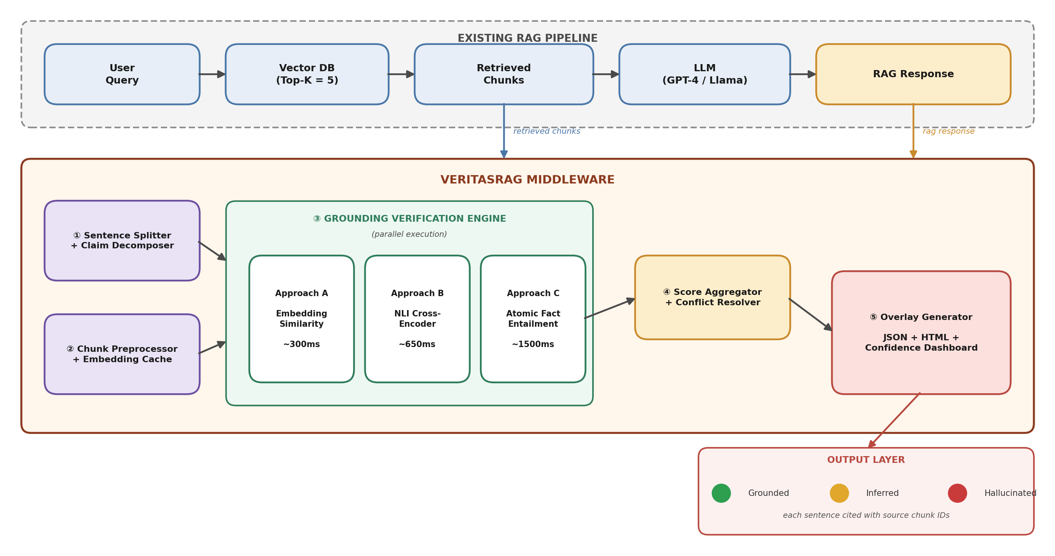
System Architecture - VeritasRAG Middleware

Slide 21
Technology Stack - VeritasRAG
Layer | Technology | Purpose
API Framework | FastAPI (Python 3.11+) | REST endpoint /api/v1/verify
Sentence Split | spaCy en_core_web_sm | Robust sentence boundary detection
Embedding Model | all-MiniLM-L6-v2 | Fast 384-dim sentence embeddings
NLI Model | DeBERTa-v3-large-MNLI | Entailment / Neutral / Contradiction
LLM (Approach C) | Llama 3.1 8B via vLLM | Atomic fact extraction
Cache | Redis 7.x | Embedding cache (LRU, 24h TTL)
Container | Docker + Compose | One-command deployment
Monitoring | Prometheus + Grafana | Latency, throughput metrics
Current Implementation Status (MVP)
Sentence Splitter, Embedding Model (Approach A), JSON Overlay, FastAPI Endpoint — Complete
Redis Cache, Docker Setup, Unit Tests — In Progress
NLI Cross-Encoder (Approach B) — Planned Week 5 | Atomic Fact Entailment (Approach C) — Planned Week 11

Slide 22
References
[1] P. Lewis et al., “Retrieval-Augmented Generation for Knowledge-Intensive NLP Tasks,” Advances in Neural Information Processing Systems (NeurIPS), 2020.
[2] S. Min et al., “FActScore: Fine-grained Atomic Evaluation of Factual Precision in Long Form Text Generation,” Proceedings of EMNLP, 2023.
[3] C. Niu et al., “RAGTruth: A Hallucination Corpus for Developing Trustworthy RAG Language Models,” Proceedings of ACL, 2024.
[4] A. Asai et al., “Self-RAG: Learning to Retrieve, Generate, and Critique through Self-Reflection,” International Conference on Learning Representations (ICLR), 2024.
[5] S. Es et al., “RAGAs: Automated Evaluation of Retrieval Augmented Generation,” Proceedings of EACL, 2024.
[6] P. Manakul, A. Liusie, and M. J. F. Gales, “SelfCheckGPT: Zero-Resource Black-Box Hallucination Detection for Generative Large Language Models,” Proceedings of EMNLP, 2023.
[7] Y. Gao et al., “Retrieval-Augmented Generation for Large Language Models: A Survey,” 2024.

Slide 23
[8] J. Wei et al., “SAFE: Search-Augmented Factuality Evaluator,” 2024.
[9] L. Huang et al., “A Survey on Hallucination in Large Language Models: Principles, Taxonomy, Challenges, and Open Questions,” 2023.
[10] P. He et al., “DeBERTa: Decoding-enhanced BERT with Disentangled Attention,” International Conference on Learning Representations (ICLR), 2021.
[11] S. Q. Yan et al., “Corrective Retrieval Augmented Generation,” 2024.
[12] S. Barnett et al., “Seven Failure Points When Engineering a Retrieval Augmented Generation System,” 2024.
[13] J. Li et al., “HaluEval: A Large-Scale Hallucination Evaluation Benchmark for Large Language Models,” Proceedings of EMNLP, 2023.
[14] P. Laban et al., “FaithBench: A Diverse Hallucination Benchmark for Summarization by Modern LLMs,” 2024.
[15] N. Reimers and I. Gurevych, “Sentence-BERT: Sentence Embeddings using Siamese BERT-Networks,” Proceedings of EMNLP-IJCNLP, 2019.

